Slide 1
Week 4- 8th Grade
Vocabulary

Slide 2
itinerary- a route of travel; a record of travel; a guidebook
On our visit to Cape Town, we had a very busy
Itinerary with exciting activities.

Slide 3
quandary- a state of perplexity or doubt
I was in a quandary over whether I should go to
school or not when I wasn’t feeling well.

Slide 4
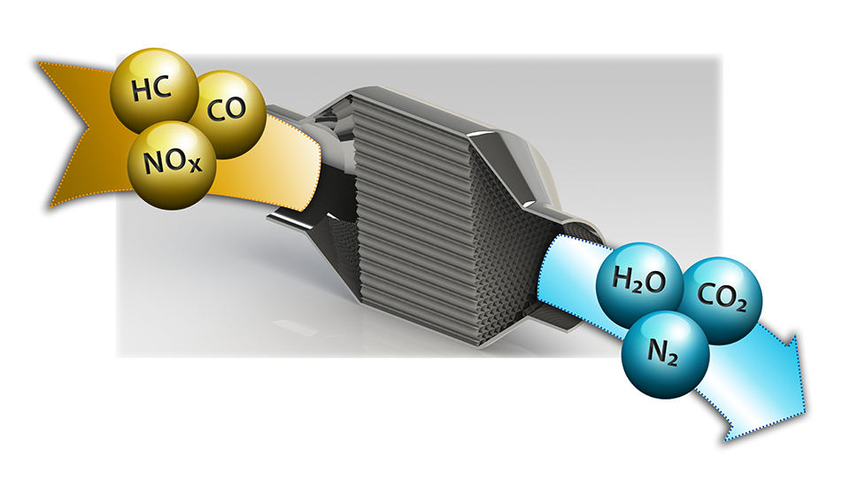
catalyst- a substance that causes or
hastens a chemical reaction; an agent that
causes change
The bombing of Pearl Harbor was a catalyst to
the United States becoming involved In World
War II.

Slide 5
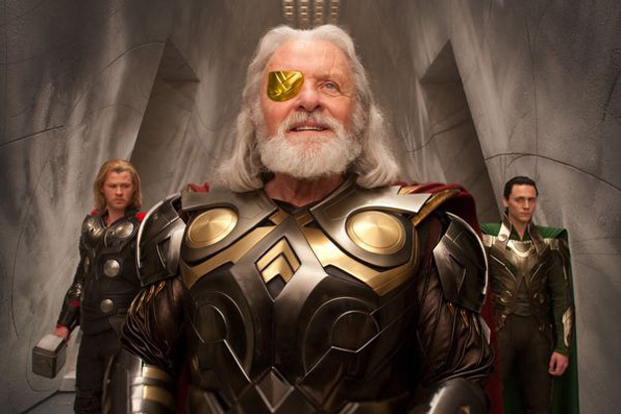
omnipotent- Almighty, having unlimited
power or authority
In the movie Thor, Odin the Norse King of
Asgard is omnipotent.

Slide 6
heritage- an inheritance; a birthright
My Polish heritage comes from my mother’s
side of my family.

